Slide 1

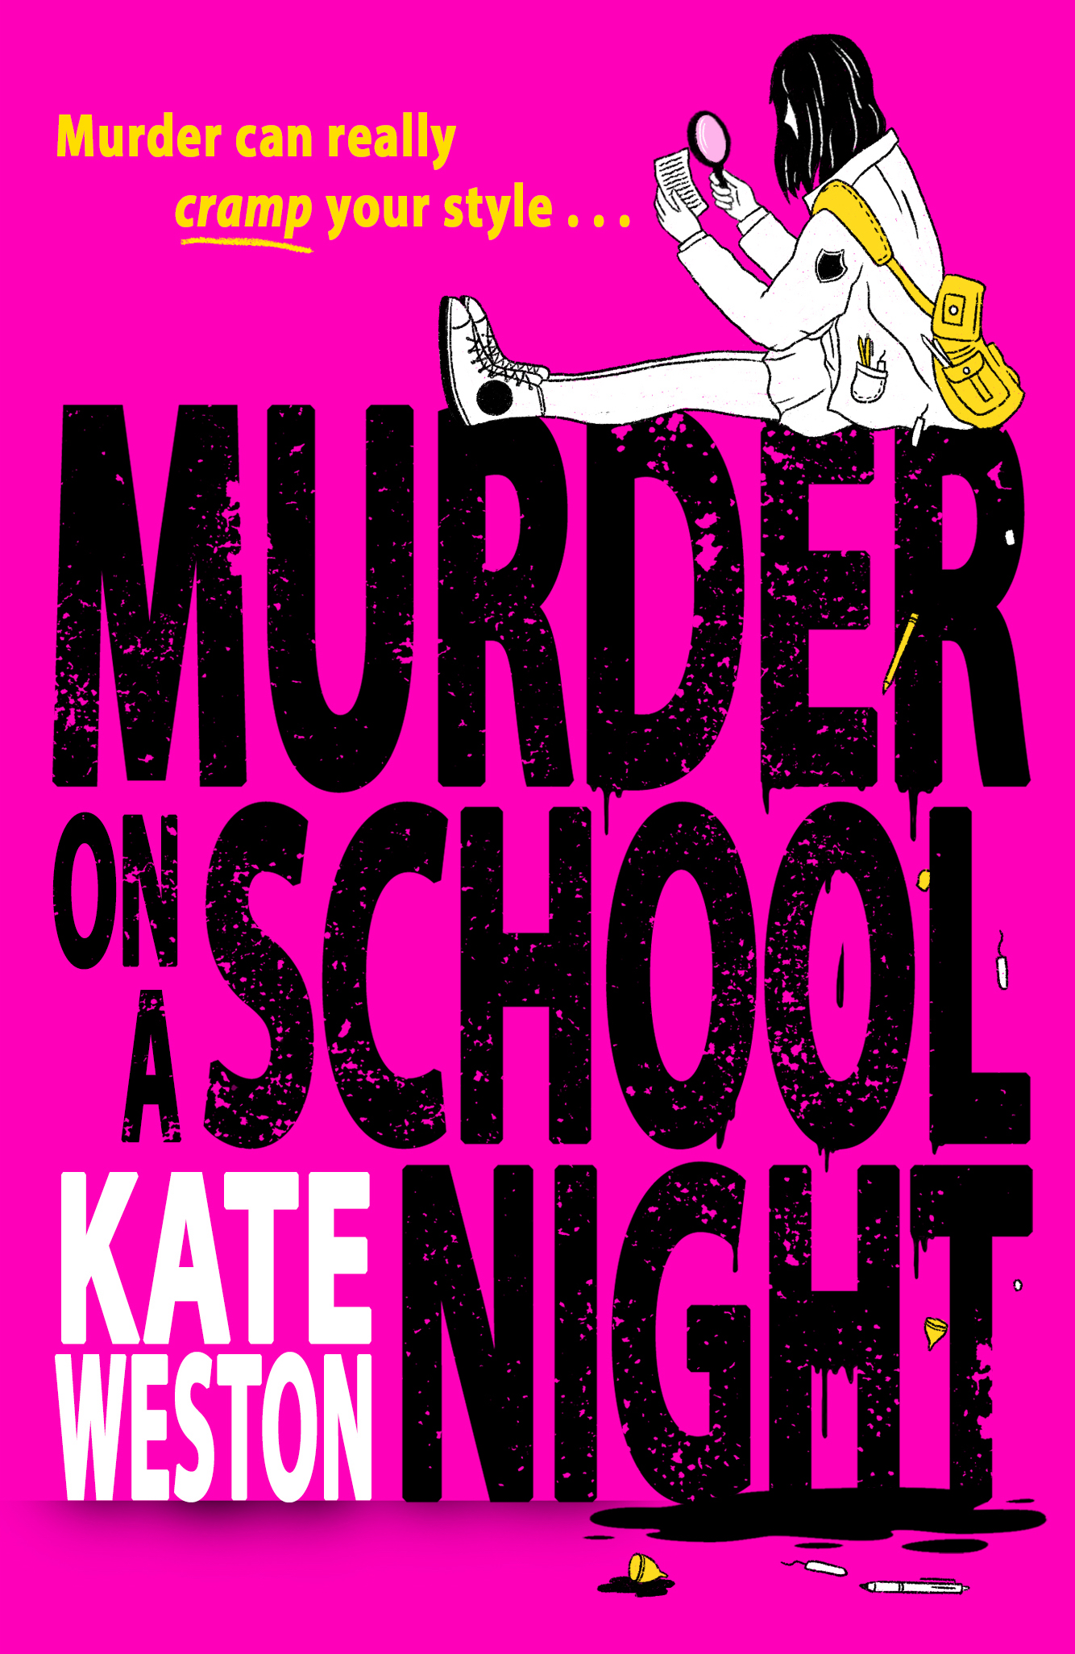
WHODUNNIT?
Plotting your own funny mystery

Slide 2
MURDER ON A SCHOOL NIGHT
Murder On A School Night is a YA comedy murder mystery where the murders are all either committed with or related to period products.
Our narrator Kerry is all set to have her first kiss with her crush Scott when they discover the dead body of one of the most popular girls at school with a menstrual cup hanging out of her mouth.
Armed with her best friend Annie, and their love of detective novels, Kerry and Annie set out to solve the mystery of the menstrual murderer.
Notes:
Hi I’m Kate Weston, and this is my book: Murder on a School Night, it’s a comedy murder mystery for Young Adults where all the murders are either committed with or involving menstrual products in some way.

Slide 3

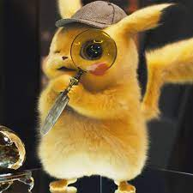
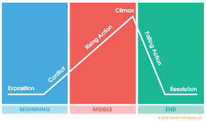



THE INGREDIENTS FOR MURDER
Notes:
With that in mind why don’t we break down the process of writing a murder mystery and look at the basics that we need!
What are the main ingredients for murder? What do you need?
Body
Detective
Motive
Evidence
Catchy plot
Red Herring
Location
Murder Weapon

Slide 4

SO IN MURDER ON A SCHOOL NIGHT IT’S…
Notes:
So in Murder on a School Night it’s this cute little menstrual cup that starts all the death and drama.

Slide 5
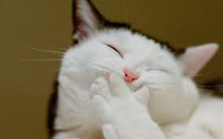
But… How do you make it funny?
...Well, what makes you laugh?
Notes:
How do you make a book funny?
What makes you laugh (Get them to raise hands again) Because if it makes you laugh, maybe it will make someone else laugh too?

Slide 6
What is funny?
The rule of 3
Absurdity and the unexpected
Repetition – Callbacks
Notes:
Tips: The rule of three and opposites attracting add examples
The unexpected - Comparing something very mundane and boring with something wild and out there. Throwing something into the mix that no one saw coming. Absurdity is funny. For instance if your teacher showed up to school one day in a lobster costume with no warning? Funny.
Callbacks – referencing something from earlier in your book that was funny and using it in a new light is comforting to people. They feel safe and they find the repetition funny. – you have to just make sure you don’t over use this one though.
So using these rules you can see that one of the things that makes Murder on a school night funny is the unlikely weapon. The unlikely detectives and the unlikely setting of a small quiet English village.

Slide 7
WANT TO START WRITING YOUR OWN MURDER MYSTERIES?
LET’S PLAY CLUEDO! …SORT OF!
What’s the crime?
What was it committed with?
Where was it committed?
And if you’ve got time:
Do you have a detective in mind?
Do you know the why? Or the evidence?
Anything more about the plot?
Notes:
In Cluedo the players solve the crimes. They find out who it was where and what with. So because we can’t plot an entire murder book in half an hour, instead we’re going to hit the basics and then go round and tell each other what we’ve come up with. See it as an inspo session.
So we want to know:
What is the crime? Doesn’t have to be murder. I’ve read some compelling books where the crime doesn’t always involve death!
What was the crime committed with?
Where was the crime committed? What’s your setting? Is it a little village? A beach? A sprawling manor house? A library.

Slide 8
Happy Mystery Writing!!!

