Slide 1
Abiola BELLO
WRITING HOME FOR CHRISTMAS
ROMANCE TROPES

Slide 2
What is a romance trope?
A romance trope is a common plot, theme or even characters that are easily recognisable to the reader.
When a reader picks up a romance novel, they will already know from the title, the cover and the blurb what sort of romance to expect.
Tropes are used in all genres from fantasy to horror but with romance it’s about bringing two characters together through a series of events that create tension, pace, lots of swoon and a happy ending.

Slide 3
The different romance tropes
Meet cute - when they first meet in a cute/embarrassing situation
Enemies to Lovers - two people that don’t get on start to fall for each other
Fake Dating - used as a matter of convenience to make someone jealous or to get out of a situation
Childhood sweethearts - first crush
Forbidden Love - think Twilight, different religion or heirarchy
Close proximity or Forced proximity - two characters in the same space
Second Chance Love - meet again later in life
Love Triangle - three people in a relationship
Popular and geek - very popular in the 90’s think She’s All That
Opposites Attract - e.g. party girl and book guy
Stuck Together - getting close but not by choice
Just Friends - friends to eventually lovers
Sick Lit - think The Fault In Our Stars
City vs Small Town

Slide 4
The best tropes to create tension are
Forced proximity
Enemies to Lovers
Fake Dating
Love Triangle
Opposites Attract
Forbidden Love

Slide 5
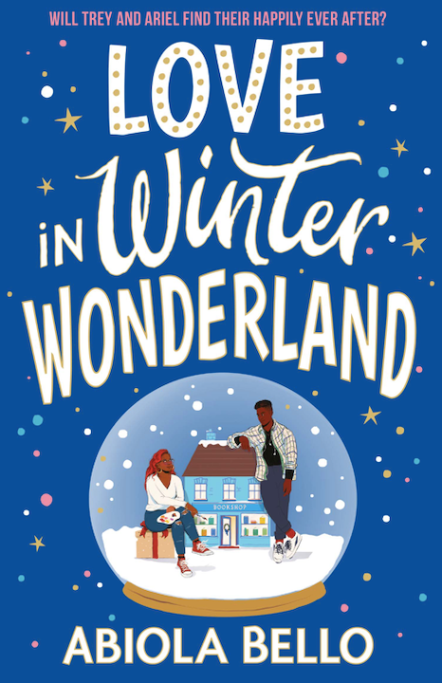
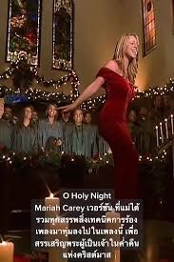
Love In Winter Wonderland
Opposites Attract
Enemies to Lovers
Love Triangle
Close Proximity
Popular/ Geek

Slide 6

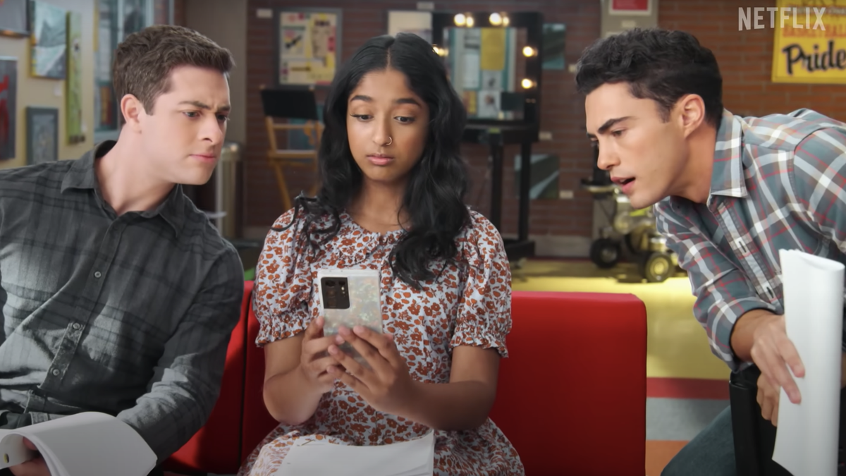
Never Have I Ever
Love Triangle
Popular and Geek
Opposites Attract
First Love
Enemies to Lovers
Second Chance Love

Slide 7

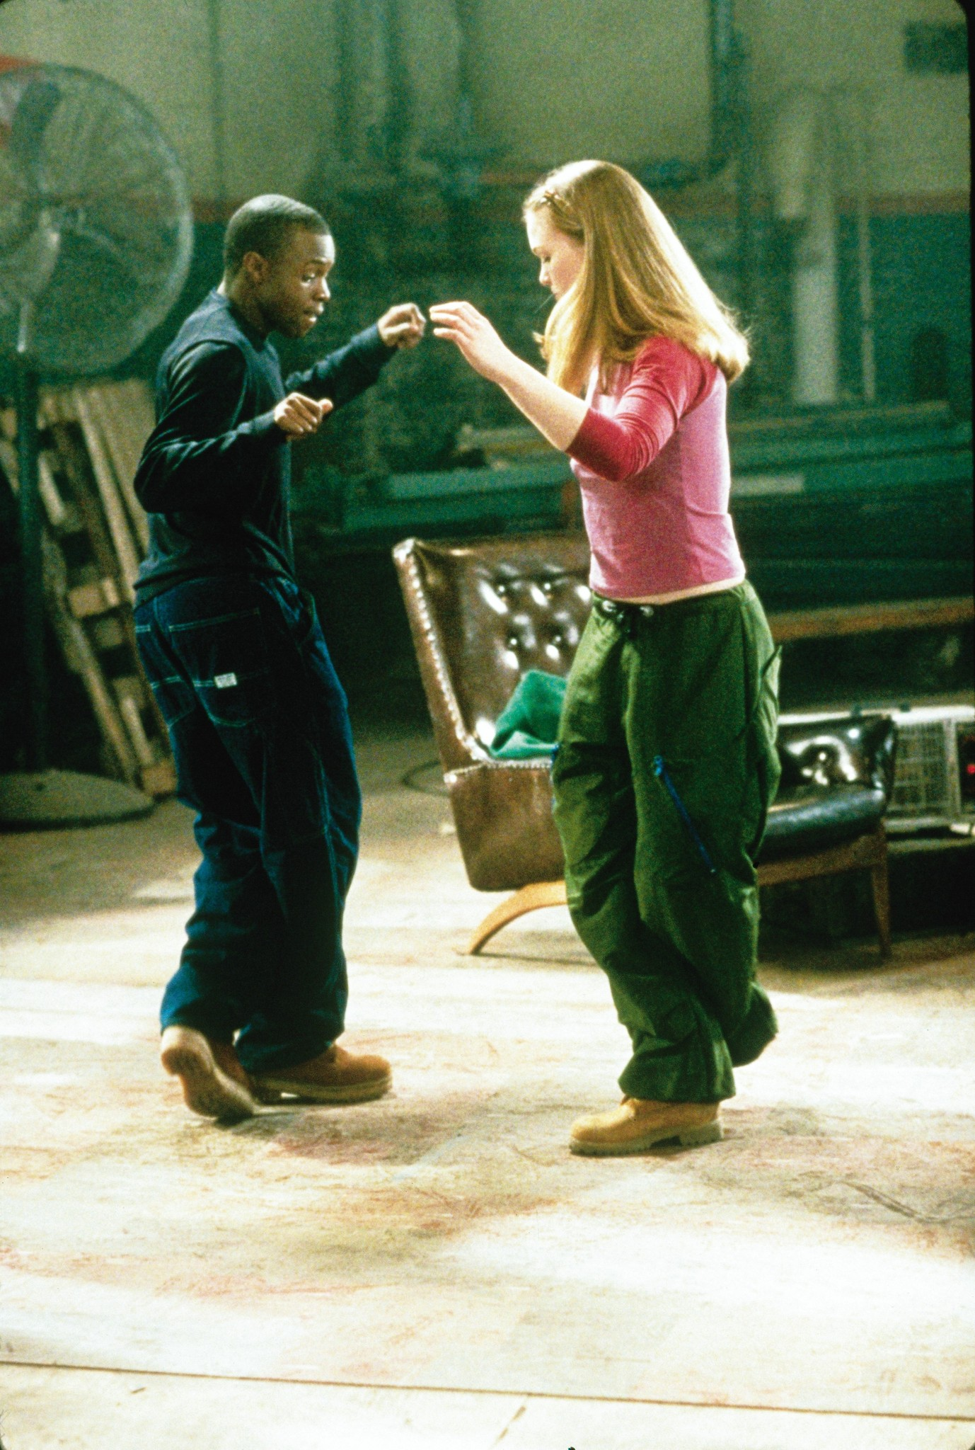
Save The Last Dance
Meet Cute
Popular and Geek
Just Friends
Opposites Attract - even down to their dance styles

Slide 8

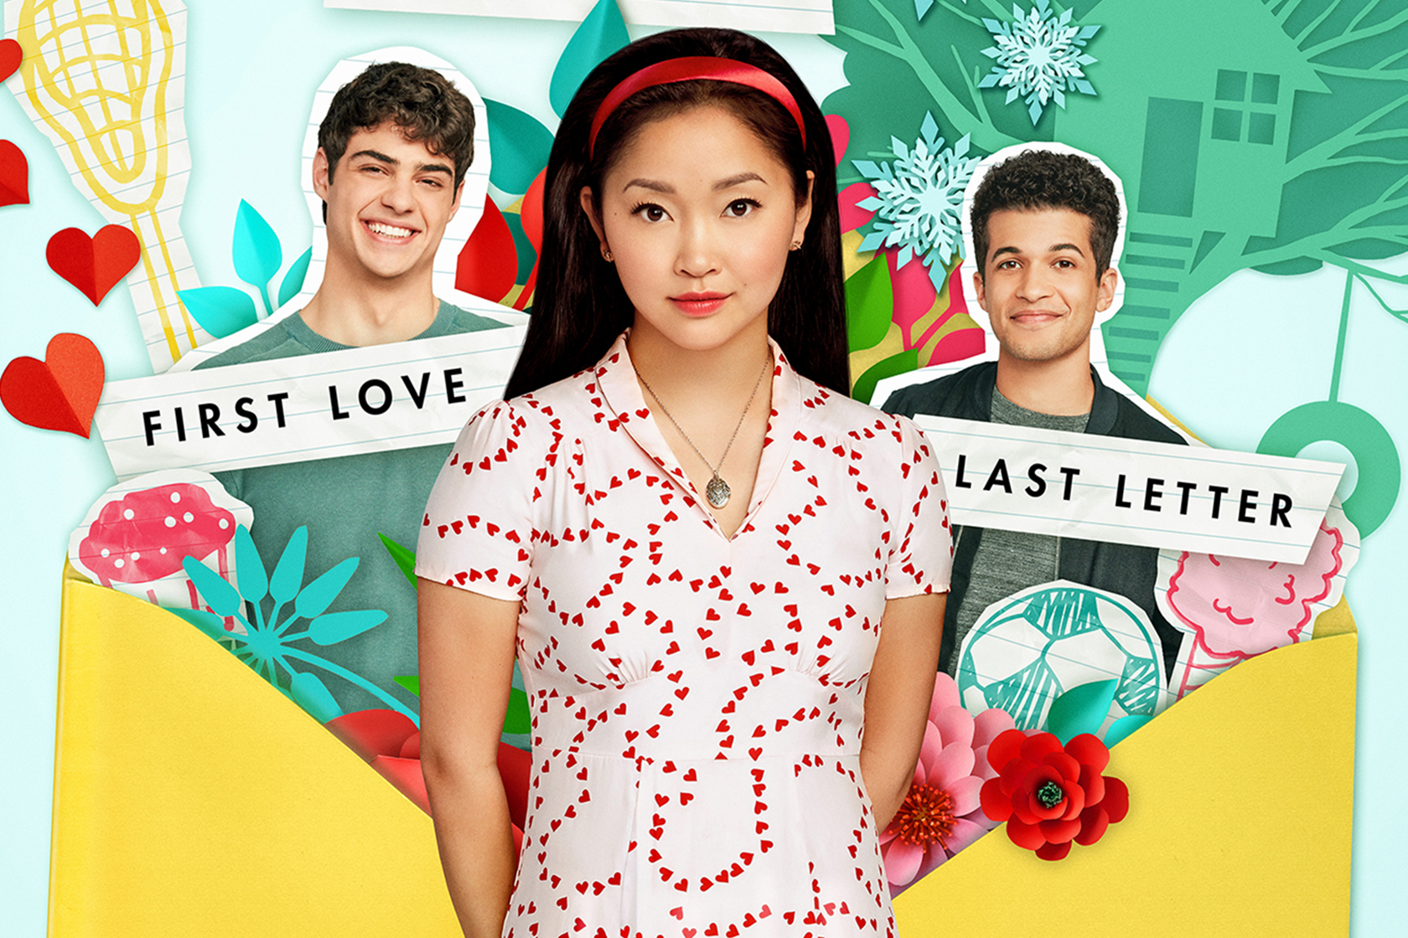
To All The Boys I’ve Loved Before
Fake Dating
Love Triangle
Childhood Sweethearts
Popular and Geek
Opposites Attract
First Love

Slide 9
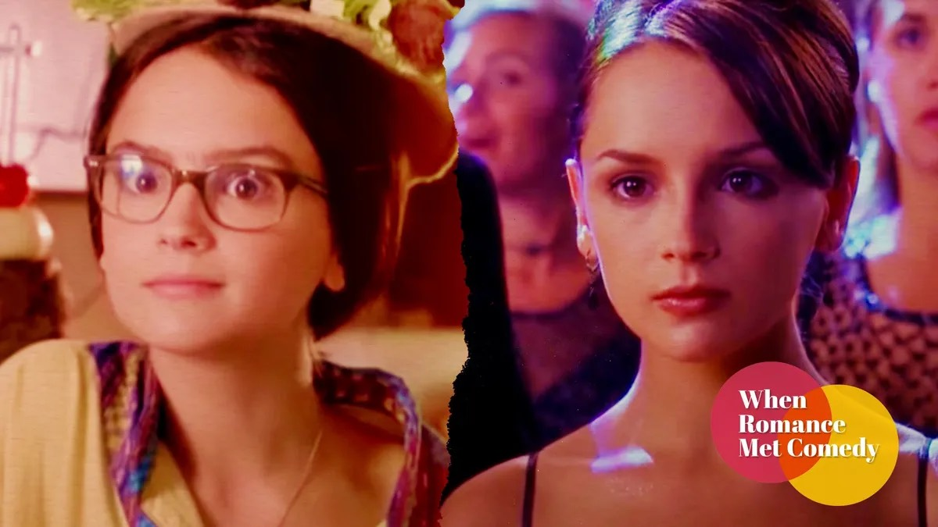
Tropes to leave behind

Slide 10
How to use a trope without falling into a cliche
An original storyline - find your niche
Strong, relatable characters with flaws!
A good setting that’s not used loads eg; Christmas, Black owned bookshop
Avoid cliche dialogue
Have lots of organic tension that builds
Secondary characters are just as important to the book as the main protagonists

Slide 11
The formula of a rom-com
Two people meet and connect - positive or negative
A series of events that test their relationship, morals and values
Happy Ending

Slide 12
My top tips in writing a romance
The reader needs to fall in love with your protagonists. Read romance and see why you connect with a character.
Tell your authentic story. If you don’t see yourself in romance books then put yourself in one.
There’s no such thing as too much swoon!
A grand finale. Think cinematic.
Your couple doesn’t need to end up together but must end on a do they, don’t they.

Slide 13
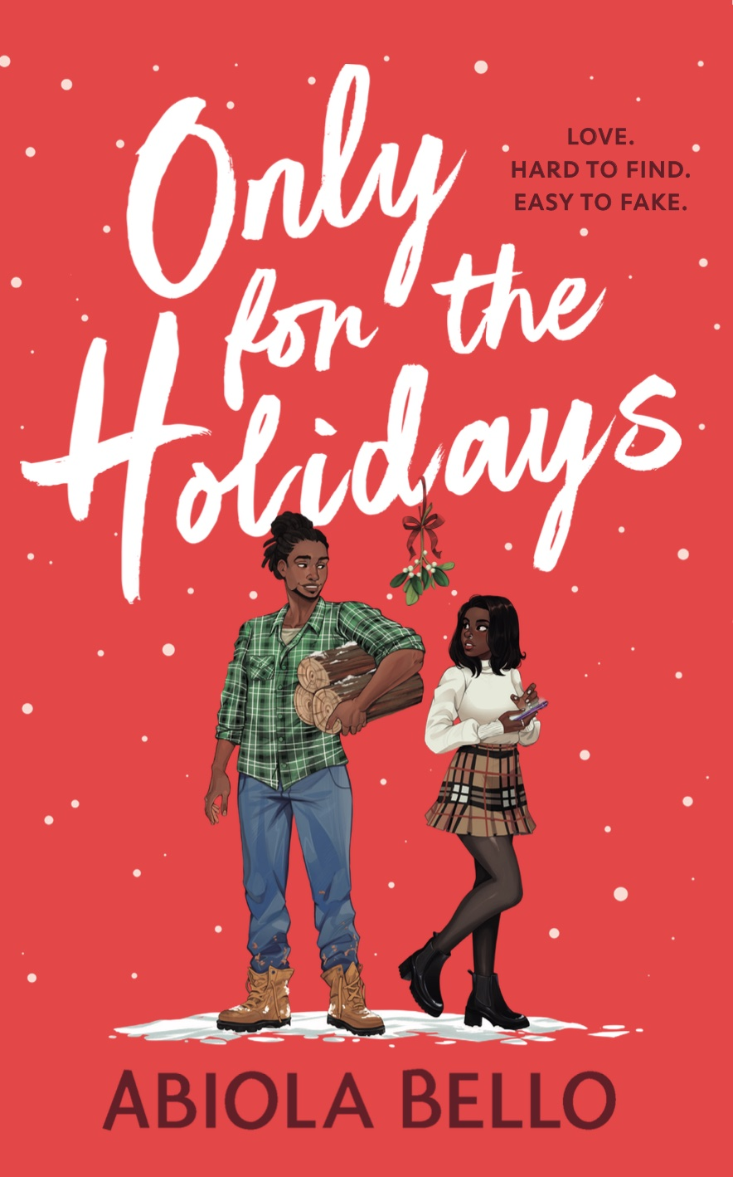
Only For The Holidays
October 12th
City Girl/
Small Town Boy
Fake Dating
Close Proximity
Opposites Attract

